Slide 1
Introduction Python Programming
Python is a general purpose high level programming language.
Python was developed by Guido Van Rossam in 1989 while working at National Research Institute at Netherlands.
But officially Python was made available to public in 1991.
The official Date of Birth for Python is : Feb 20th 1991.
Python is recommended as first programming language for beginners.
The name Python was selected from the TV Show "The Complete Monty Python's Circus", which was
broadcasted in BBC channel from 1969 to 1974
Guido developed Python language by taking almost all programming features from different languages
Functional Programming Features from C
Object Oriented Programming Features from C++
Scripting Language Features from Perl and Shell Script
Modular Programming Features from Modula-3
Most of syntax in Python Derived from C and ABC languages.

Slide 2
Where we can use Python
We can use everywhere. The most common important application areas are
For developing Desktop Applications
For developing web Applications
For developing database Applications
For Network Programming
For developing games
For Data Analysis Applications
For Machine Learning
For developing Artificial Intelligence Applications
For IOT
Note:
Internally Google and Youtube use Python coding
NASA and Nework Stock Exchange Applications developed by Python. Top Software companies like Google, Microsoft, IBM, Yahoo using Python.

Slide 3
Eg1: To print Helloworld:
Python:
print("Hello World")
Eg2: To print the sum of 2 numbers
1) | a=10
2) | b=20
3) | print("The Sum:",(a+b))

Slide 4
Features of Python:
Simple and easy to learn
Freeware and Open Source
high level programming
Platform Independent
Portability
Dynamically Typed
Both Procedure Oriented and Object Oriented
Interpreted:
Extensible
Embedded
Extensive Library
Limitations of Python:
Performance wise not up to the mark b'z it is interpreted language.
Not using for mobile Applications

Slide 5
Flavors of Python:
CPython:
It is the standard flavor of Python. It can be used to work with C lanugage Applications
Jython or JPython:
It is for Java Applications. It can run on JVM
IronPython:
It is for C#.Net platform
PyPy:
The main advantage of PyPy is performance will be improved because JIT compiler is available inside PVM.
RubyPython
For Ruby Platforms
Anaconda Python
It is specially designed for handling large volume of data processing.

Slide 6
Python Versions:
Python 1.0V introduced in Jan 1994 Python 2.0V introduced in October 2000 Python 3.0V introduced in December 2008
Note: Python 3 won't provide backward compatibility to Python2
i.e there is no guarantee that Python2 programs will run in Python3. Current versions
Python 3.14.3 Python 2.7.13

Slide 7
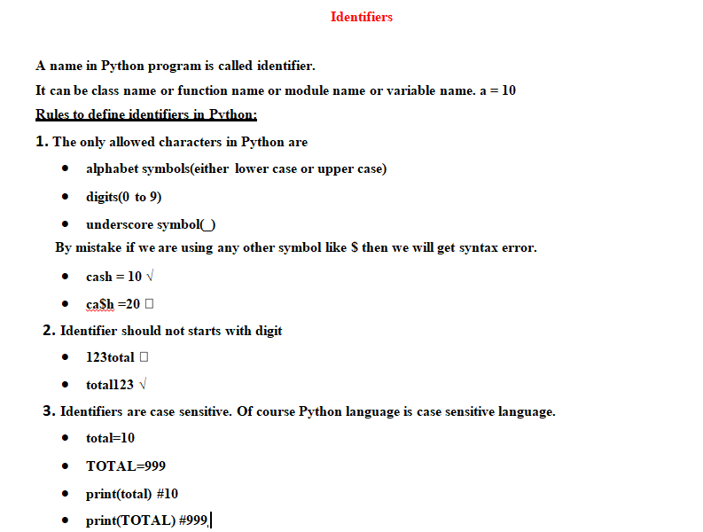

Slide 8
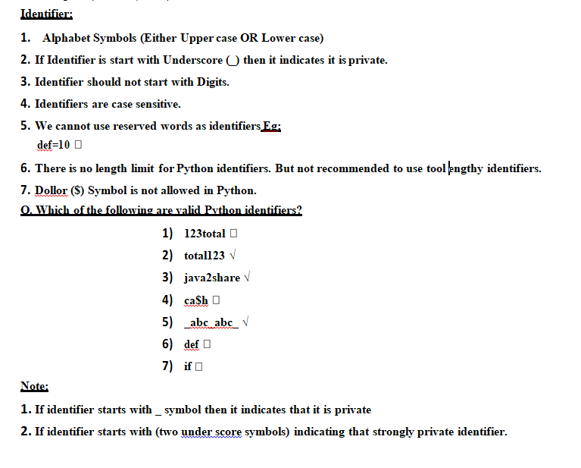

Slide 9
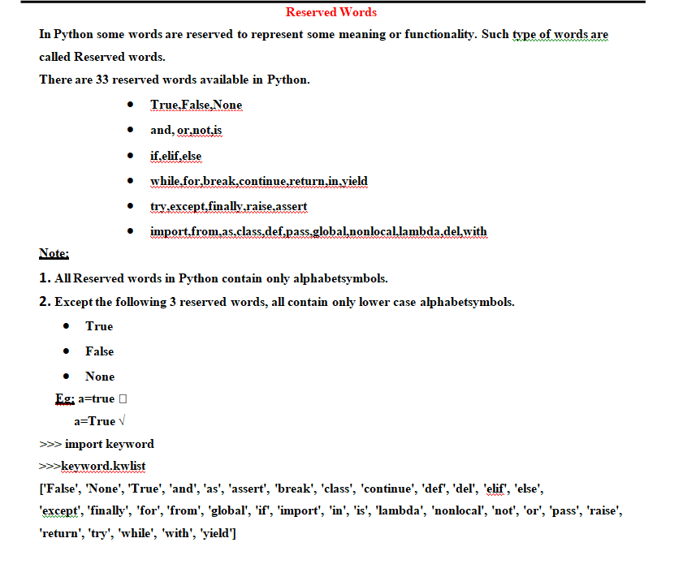

Slide 10
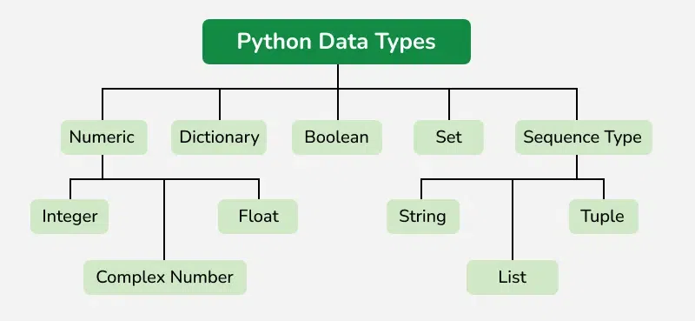

Slide 11
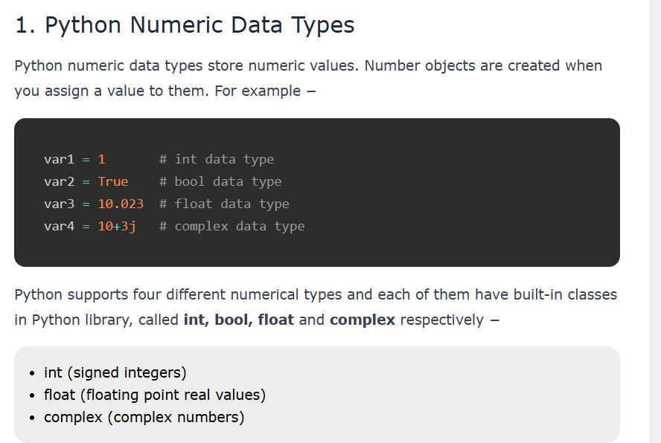

Slide 12
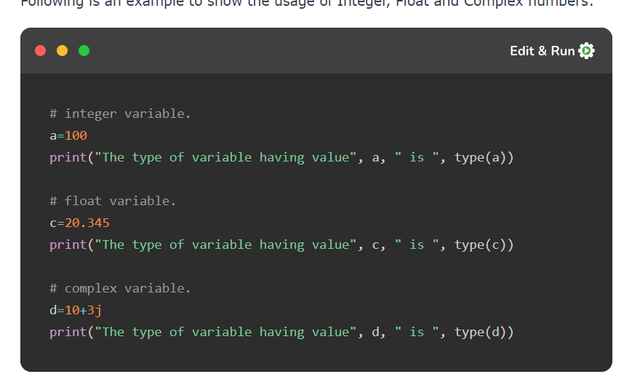
a=10+1.5j
b=20+2.5j
c=a+b
print(c)

Slide 13
The Python input() function provides a way to accept input from the user. It holds the program's execution and waits for the user to provide the required input. You can also use the prompt parameter to display a custom message to the user before the input.
The input() function is one of the commonly used built-in functions, and you can use this method directly without importing any module. It accepts any type of data but returns the given data in the string format.
There are some functions that are used with input() (such as int(), float(), etc.) to convert the given input in a specific type of format.
Syntax
Following is the syntax of the Python input() function −
input(message)
Return Value
The Python input() function returns a String containing the user input.

Slide 14
EX1: Source code
EnterOrgName = input("Enter your organisation name: ")
print(f"Welcome to, {EnterOrgName}")
Output:
Enter your organisation name: srisri
Welcome to, srisri
EX2: Source code
numOne = float(input("Enter first num: "))
numTwo = int(input("Enter second num: "))
addition = numOne + numTwo
print(f"The sum of {numOne} and {numTwo} is {addition}")
Output: Enter first num: 5
Enter second num: 8
The sum of 5.0 and 8 is 13.0

